Slide 1

Codergirl – Frontend
Unit 2 - Class 5
December 14, 2020
Notes:
1

Slide 2
Agenda
Section 7
Attribute and Structural Directives
Building our own
Studio on Directives
Section 8
Work on your own project and apply directives.
Notes:
2

Slide 3
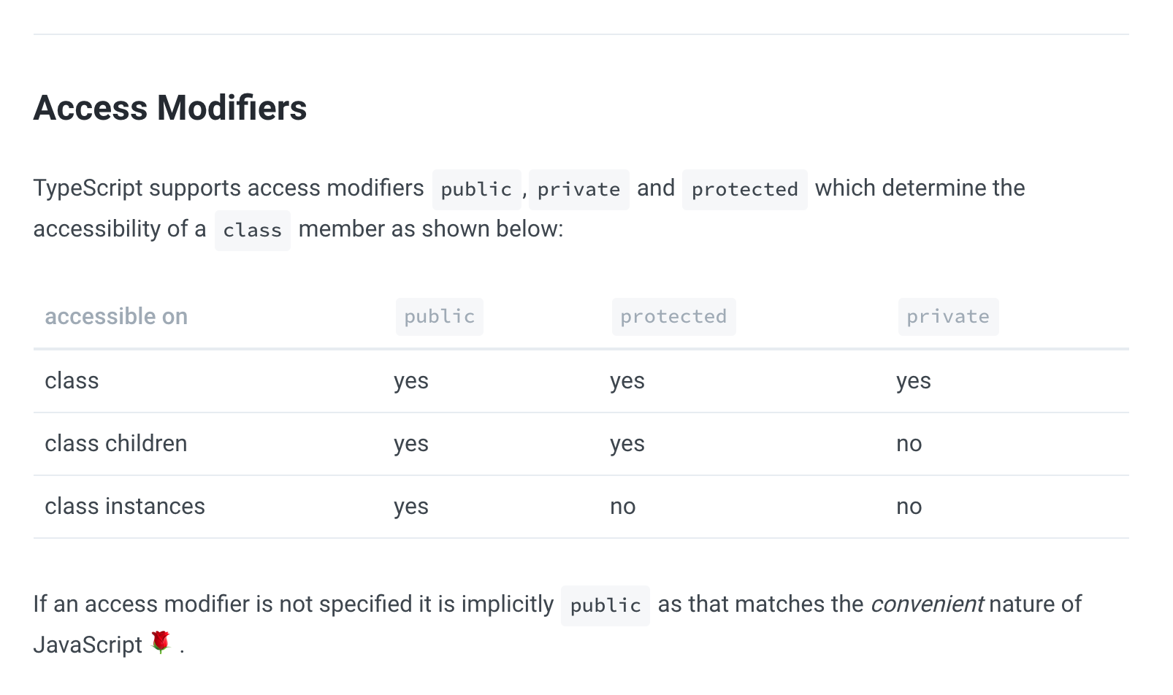
Access Modifiers
Notes:
https://basarat.gitbook.io/typescript/future-javascript/classes#access-modifiers
https://medium.com/young-coder/private-fields-in-typescript-3-8-true-privacy-at-last-fb4f194305d9
3

Slide 4
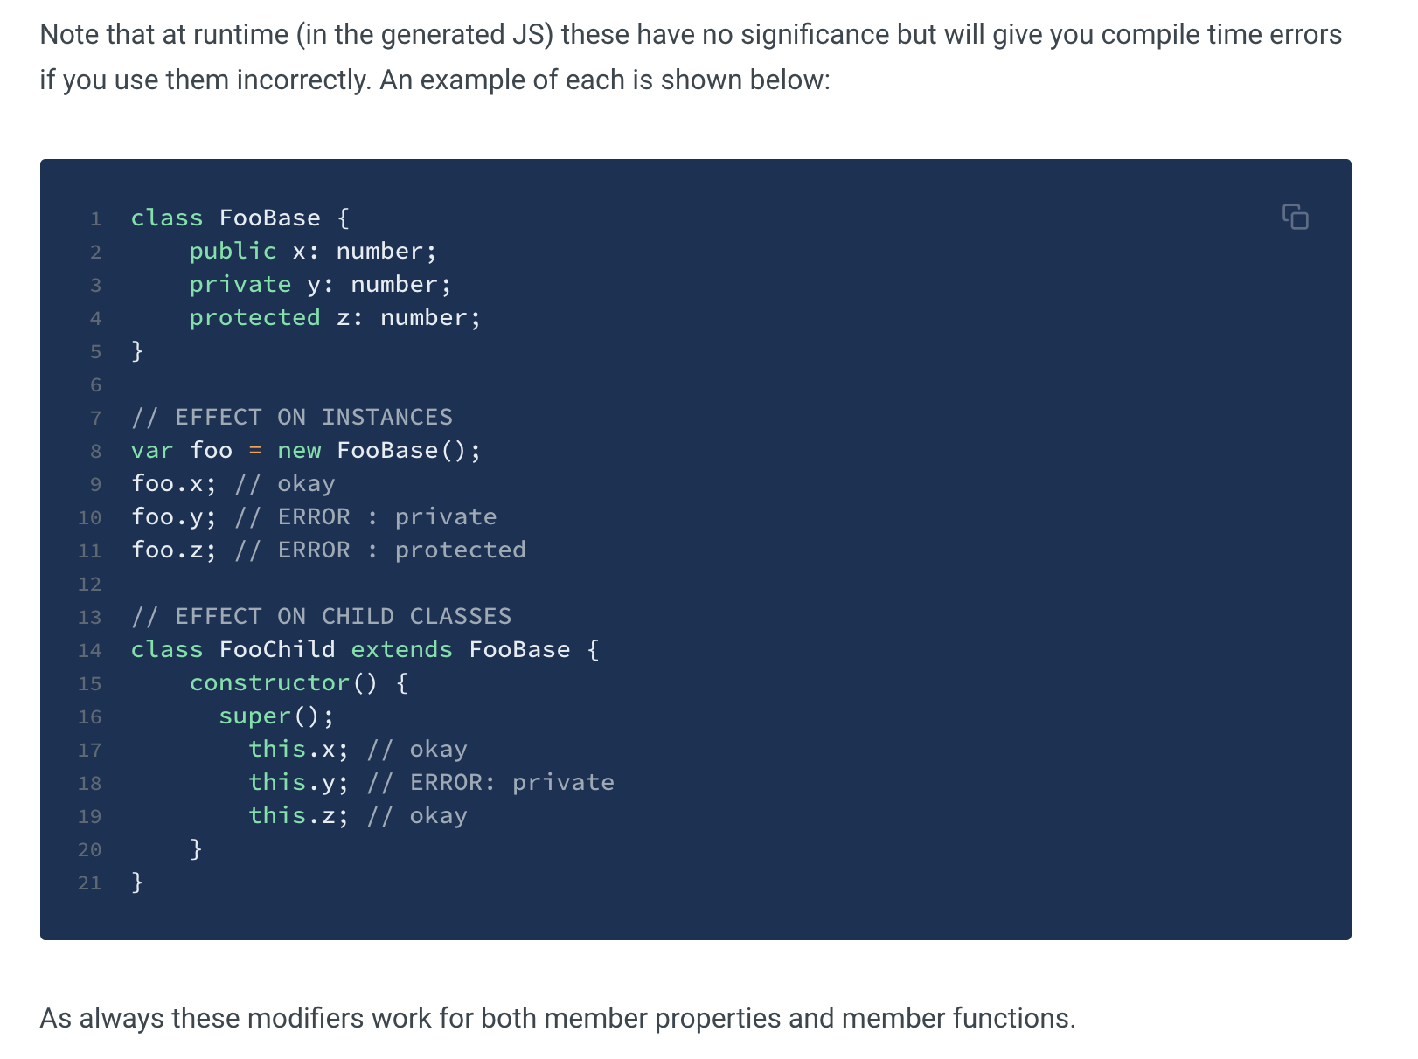
Access Modifiers
Notes:
https://basarat.gitbook.io/typescript/future-javascript/classes#access-modifiers
https://medium.com/young-coder/private-fields-in-typescript-3-8-true-privacy-at-last-fb4f194305d9
4

Slide 5
Access Modifiers
https://medium.com/young-coder/private-fields-in-typescript-3-8-true-privacy-at-last-fb4f194305d9
Notes:
https://basarat.gitbook.io/typescript/future-javascript/classes#access-modifiers
https://medium.com/young-coder/private-fields-in-typescript-3-8-true-privacy-at-last-fb4f194305d9
5

Slide 6
Structural Directives
Only one structural directive can be applied to the same element
ngFor and ngIf
Exercise
Notes:
https://basarat.gitbook.io/typescript/future-javascript/classes#access-modifiers
https://medium.com/young-coder/private-fields-in-typescript-3-8-true-privacy-at-last-fb4f194305d9
6

Slide 7
Structural Directives
Notes:
7

Slide 8
Structural Directives
Notes:
8

Slide 9
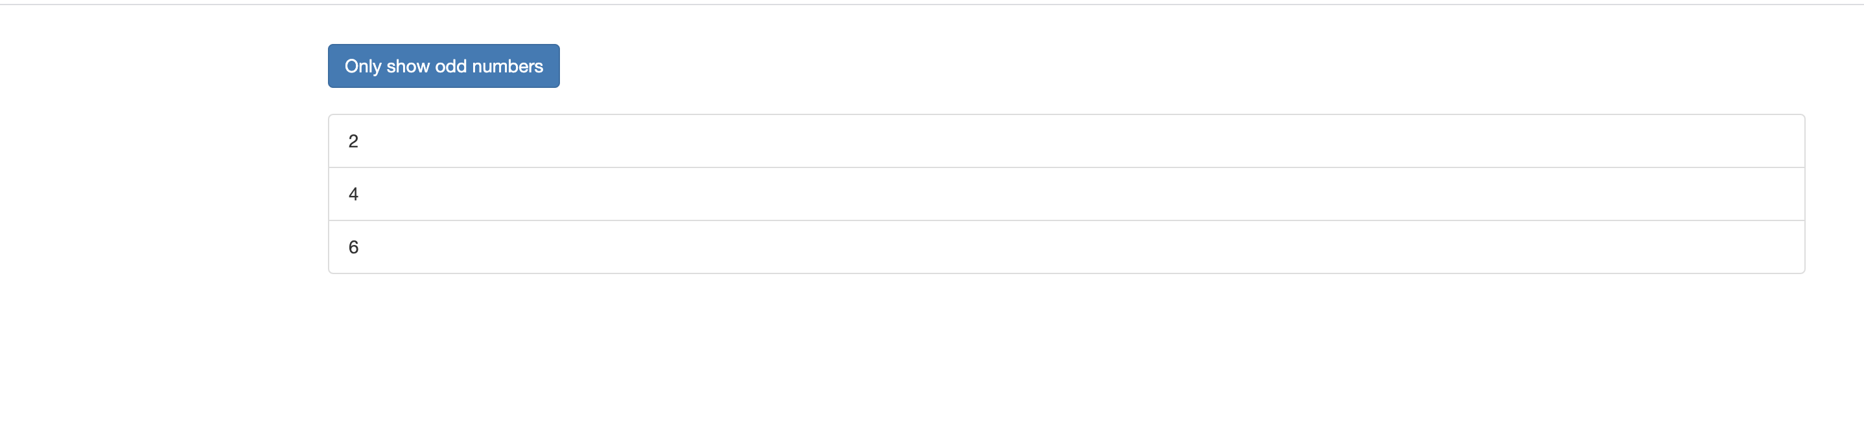
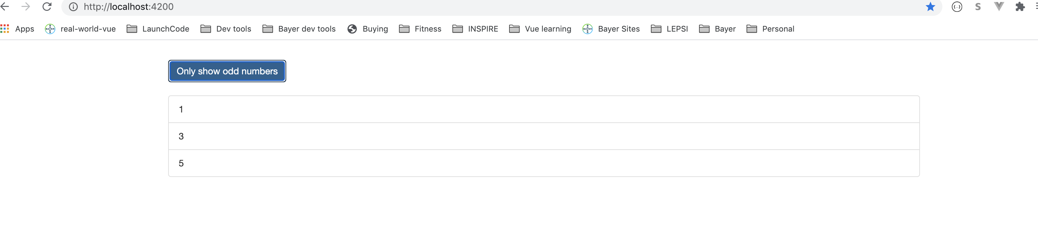
Structural Directives
Notes:
9

Slide 10
ngClass – [] means binding to ngClass directive
ngClass of odd gets assigned if the condition evaluates to true
Notes:
10

Slide 11
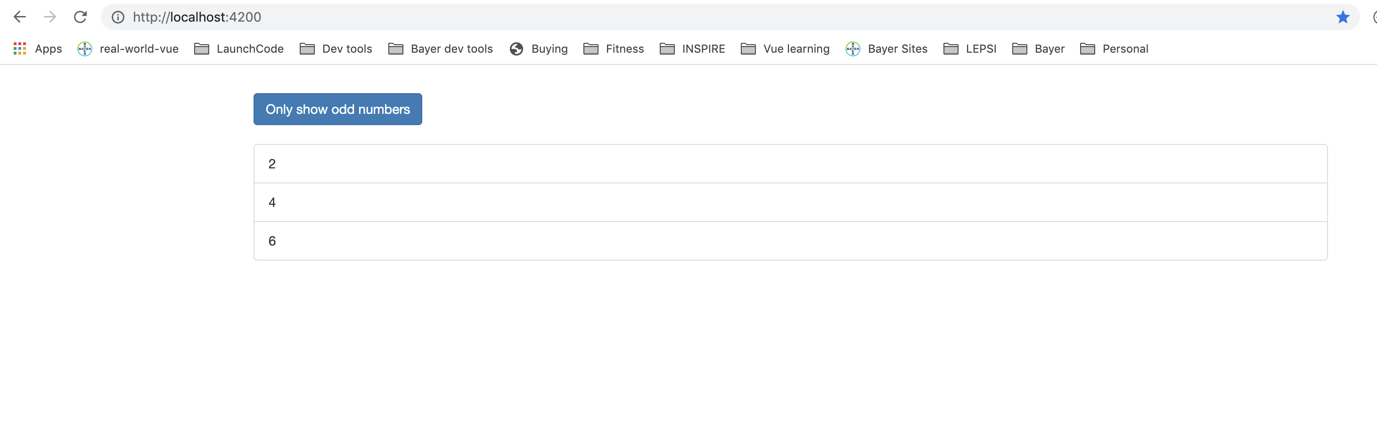
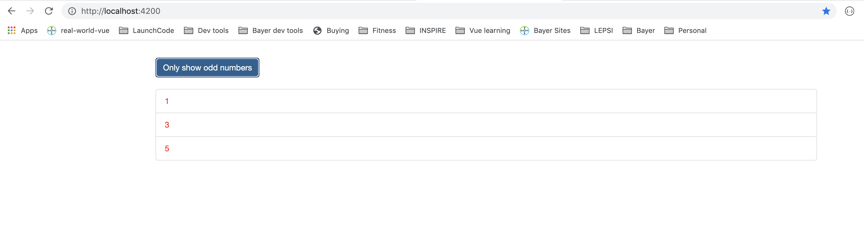
ngClass
Notes:
11

Slide 12
ngStyle
app-component.html
Notes:
12

Slide 13
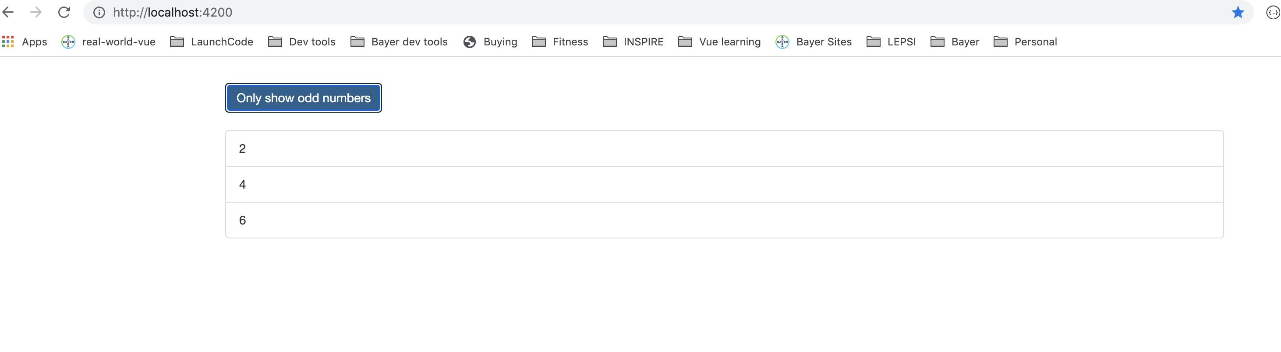
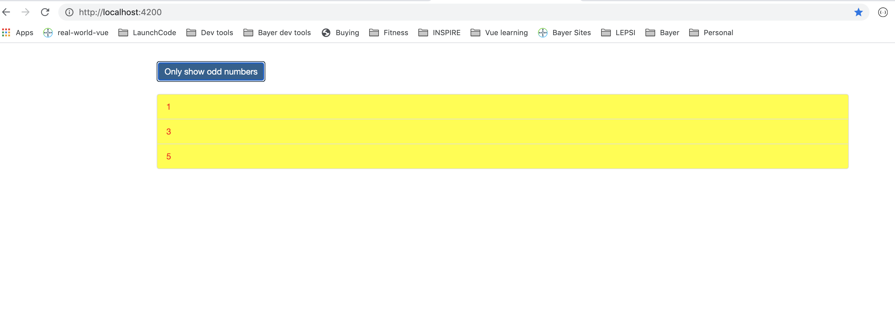
ngStyle
Notes:
13

Slide 14
Building our own directive
Goal: Build a directive which highlights an element when I hover over it.
Create a new file called basic-hightlight.directive.ts
Add the @Directive and import it
Angular injects the element into the class that the directive sits on
Easy way to get access to classes – injection
Angular will try to give the reference to the elementusing elementRef
Access of private makes it a property of class and accessible to class.
Use the elementRef in the ngOnInit method.
Have to inform Angular about the directive (most things setup wise are in the app.module.ts)
Notes:
14

Slide 15
Making your own directive
basic-highlight.directive.ts
The square bracket signify it’s an attribute
Notes:
15

Slide 16
Setup for your own directive
app.component.html
Notes:
16

Slide 17
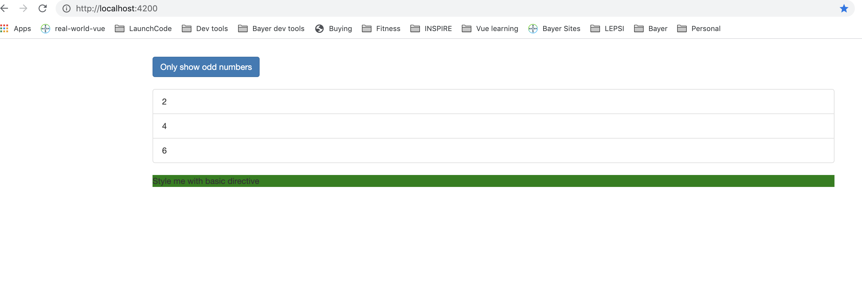
Setup my own directive
Notes:
17

Slide 18
Using Renderer to build directive
Accessing elements directly is not a great idea
Create director using cli
ng g d better-highlight or
ng generate directive better-highlight
You can create a common folder for directives or use better-highlight folder
Access to DOM might not always be possible if app not accessible in browser. Mostly both work!
Notes:
18

Slide 19
Using Renderer to build directive
better-highlight.directive.ts
Notes:
19

Slide 20
Using Renderer to build directive
app.component.html
Notes:
20

Slide 21
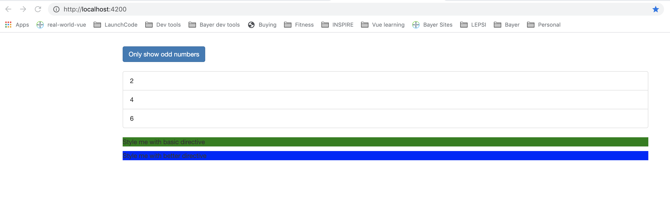
Using Renderer to build directive
Notes:
21

Slide 22
HostListener
recipe-list.component.html
better-highlight.directive.ts
Notes:
22

Slide 23
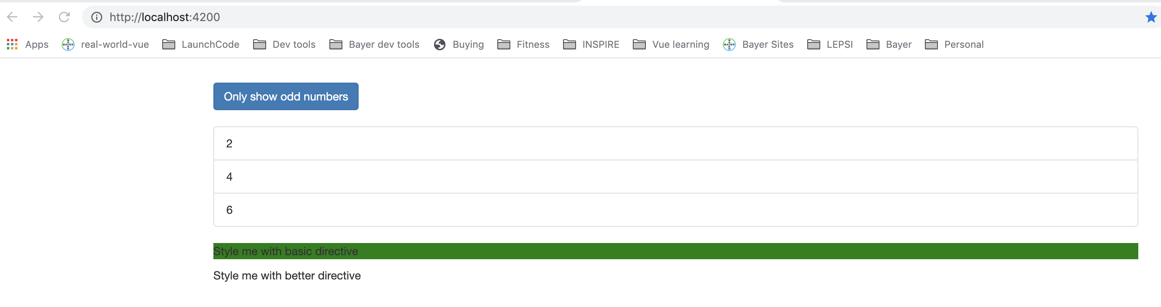
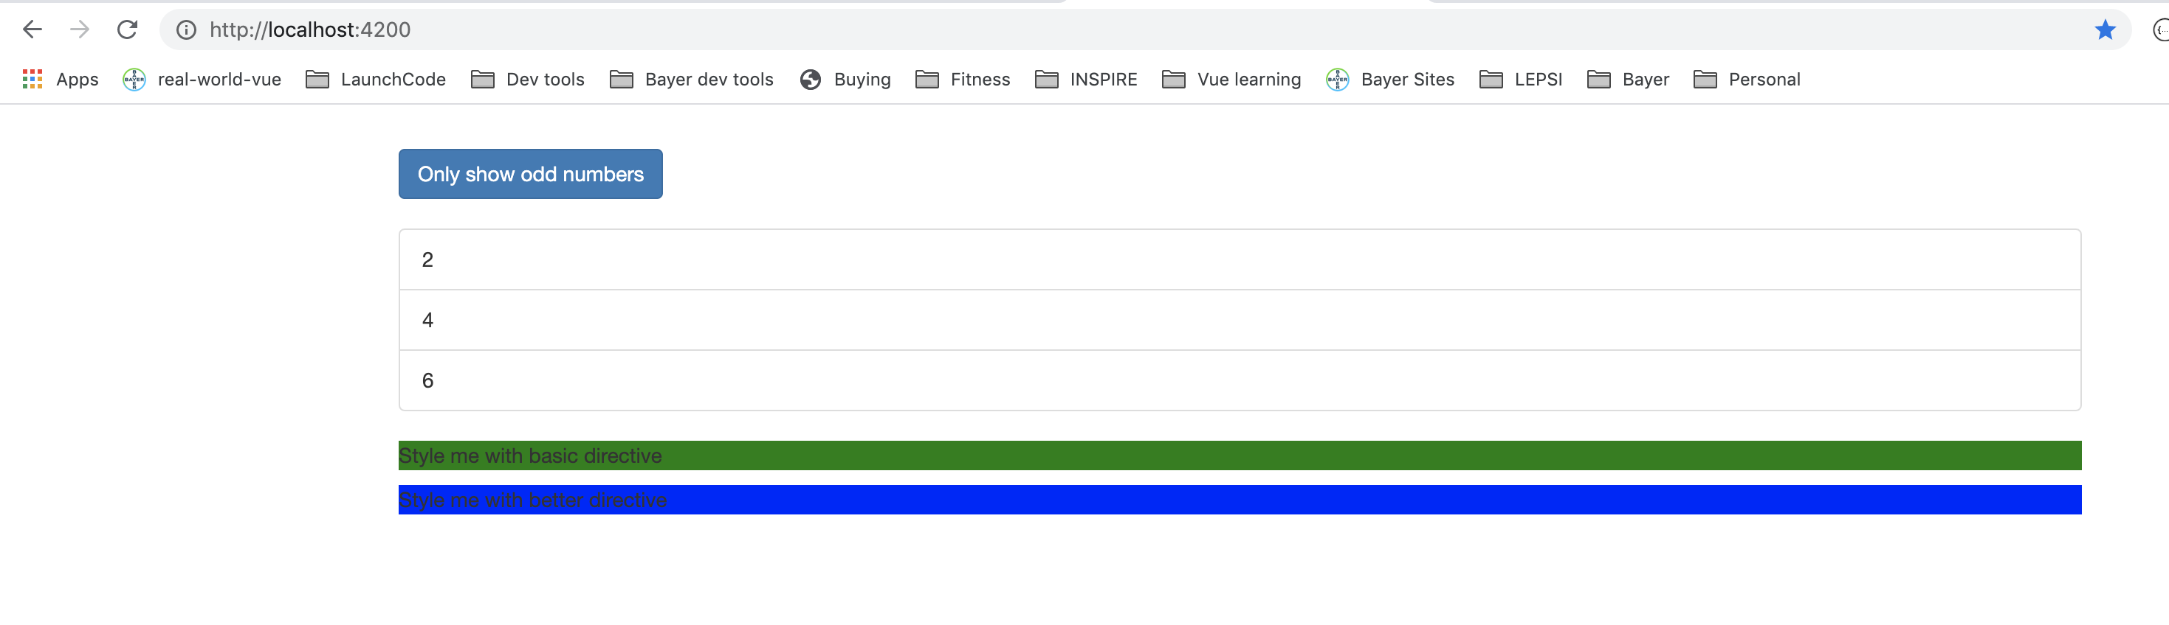
HostListener
Notes:
23

Slide 24
HostBinding
Notes:
24

Slide 25
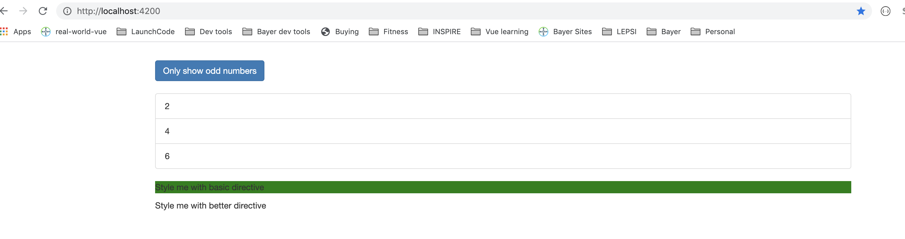
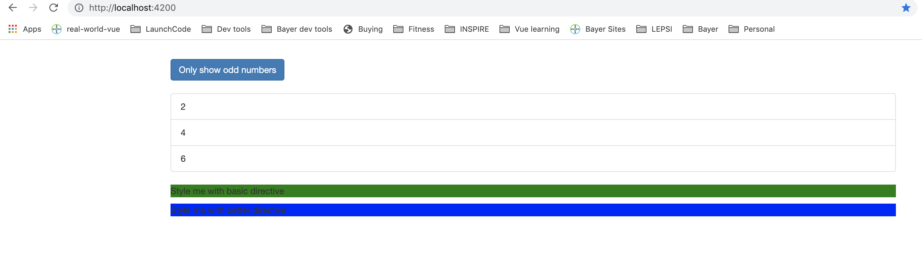
HostBinding
Notes:
25

Slide 26
Binding to Directive Properties
Notes:
26

Slide 27
Binding to Directive Properties
Notes:
27

Slide 28
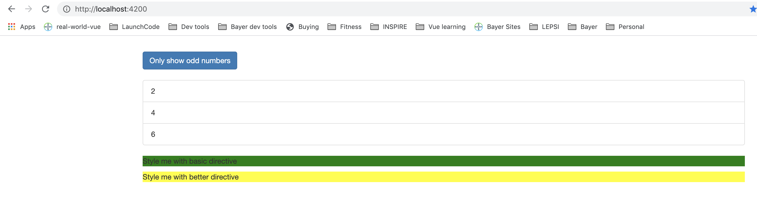
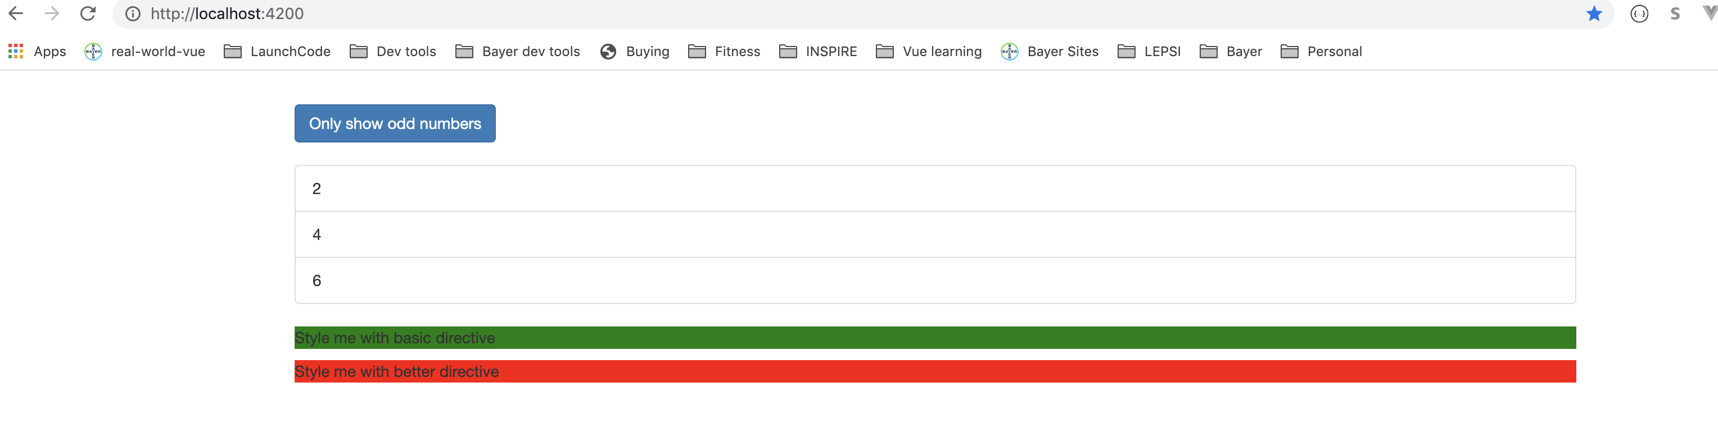
Binding to Directive Properties
Notes:
28

Slide 29
Binding to Directive Properties Notes
Angular figures out whether u passing Property of directive or the tag
Can omit square brackets for property binding and ‘’ if passing string
Notes:
29

Slide 30
Story behind *
Angular transforms *
Notes:
30

Slide 31
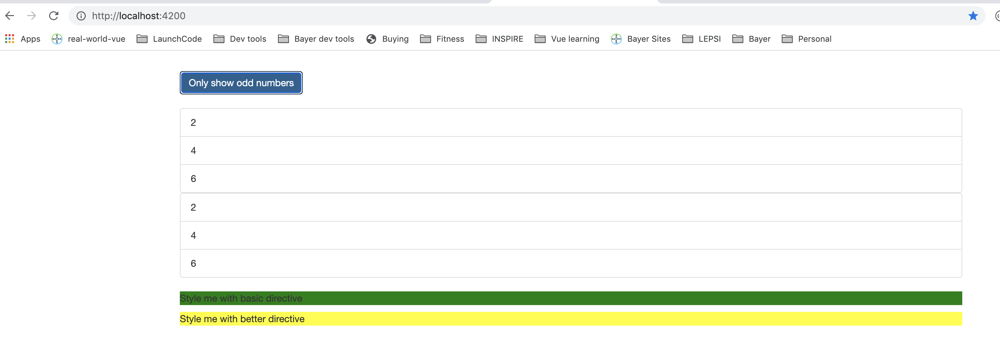
Story behind *
Notes:
31

Slide 32
Building an unless directive – ng g d unless
Notes:
32

Slide 33
Building an unless directive
Notes:
33

Slide 34
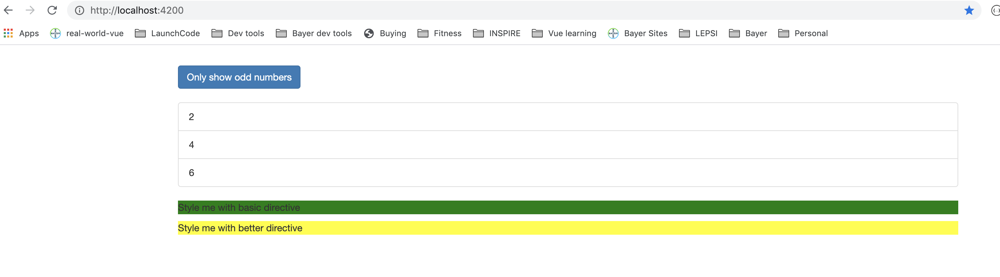
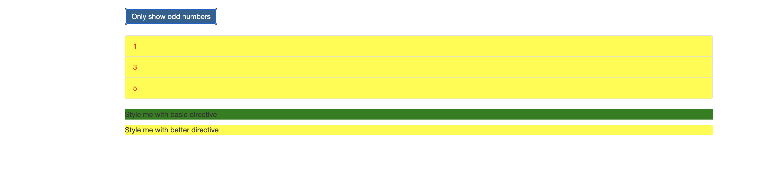
Building an unless directive
Notes:
34

Slide 35
ngSwitch
Notes:
35

Slide 36
ngSwitch
Notes:
36

Slide 37
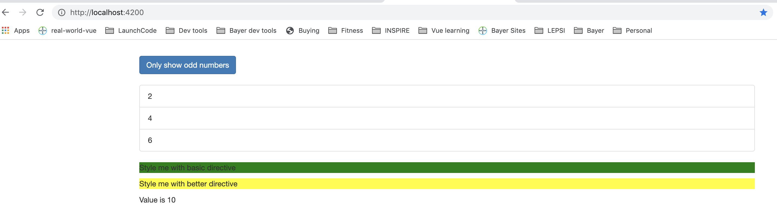
ngSwitch
Notes:
37

Slide 38
Questions?

Slide 39
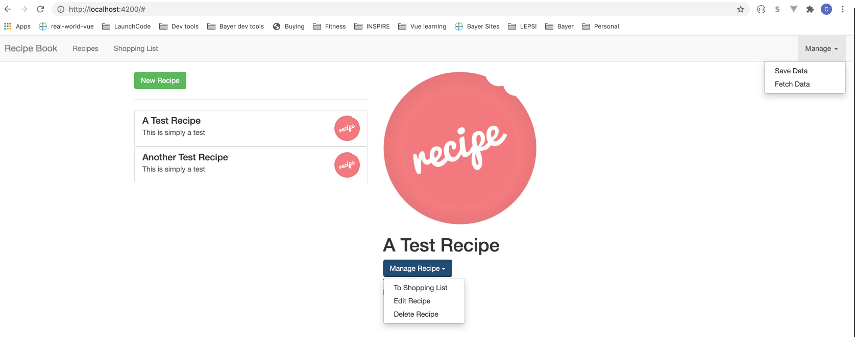
Studio
Create dropdown directive

